Slide 1
Final Project Presentation
Team: Daniel Matlock
Date: 5/21/2024

Slide 2
Table Of Contents
Data Description and Problem Definition
Data Importing and Processing
Data Analysis and Visualization
Data Analytics

Slide 3
Data Description and Problem Definition

Slide 4
Data Description and Problem Definition
Describes (almost) every aspect of residential homes in Ames, Iowa
79 explanatory variables
Goal: predict the final price of each home
Location: https://www.kaggle.com/competitions/house-prices-advanced-regression-techniques/data

Slide 5
Data Importing and Processing

Slide 6
Data Importing and Processing
Target Variable: Sale Price
1460 Total Records
43 Categorical Variables
37 Continuous Variables (including Sale Price)
Variables: Lot area, house style, year built, overall quality, 1st & 2nd floor square footage, # of bedrooms, # of bathrooms, kitchen quality, neighborhood name, zip code, etc.

Slide 7
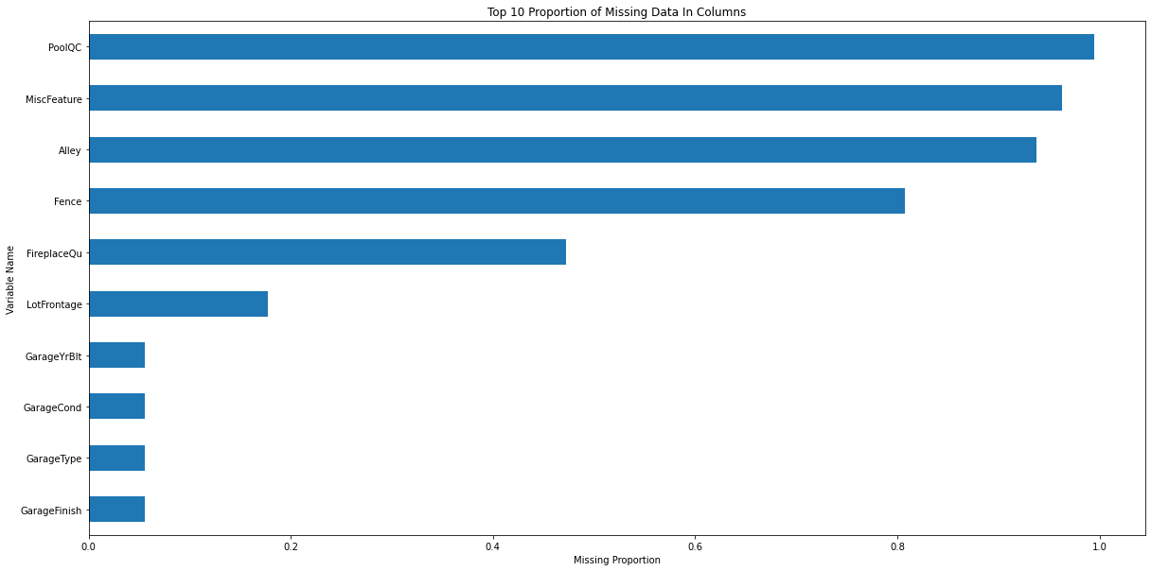
Data Importing and Processing

Slide 8
Data Importing and Processing
Imputed PoolQC missing data as “None”
Imputed other columns missing data as “None” (Alley, Fence, Garage Type, etc.)
Imputed some contentious variables with the Median (Lot footage by neighborhood)
Imputed Sale Type and Kitchen variables quality with the mode
Dropped the Utilities column
After doing all this there were no missing values

Slide 9
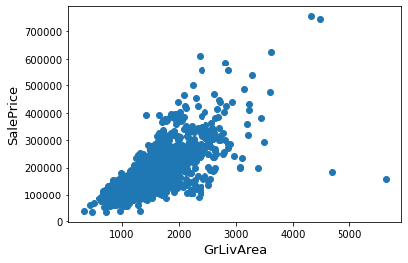
Data Importing and Processing
Handling outliers
Removed outliers where Living Area > 4000 and Sale Price is less than 300,000

Slide 10
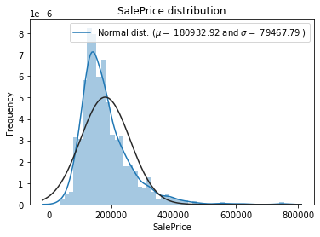
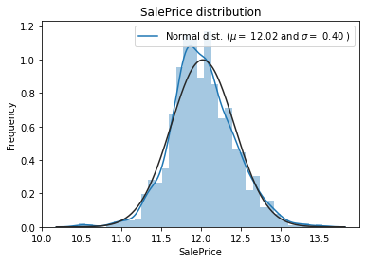
Data Importing and Processing
Normalized target variable (Sale Price) to reduce skew

Slide 11
Data Analysis and Visualization

Slide 12
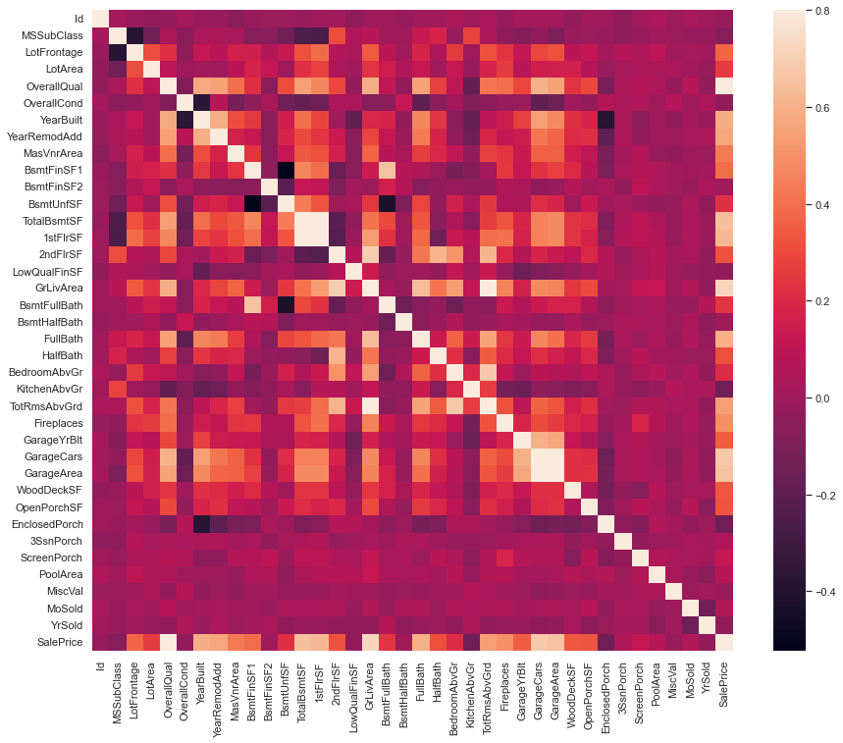
Data Analysis and Visualization
Looked at correlation matrix to determine if there were andy highly correlated variables with our target variable
We see there are quite a few

Slide 13
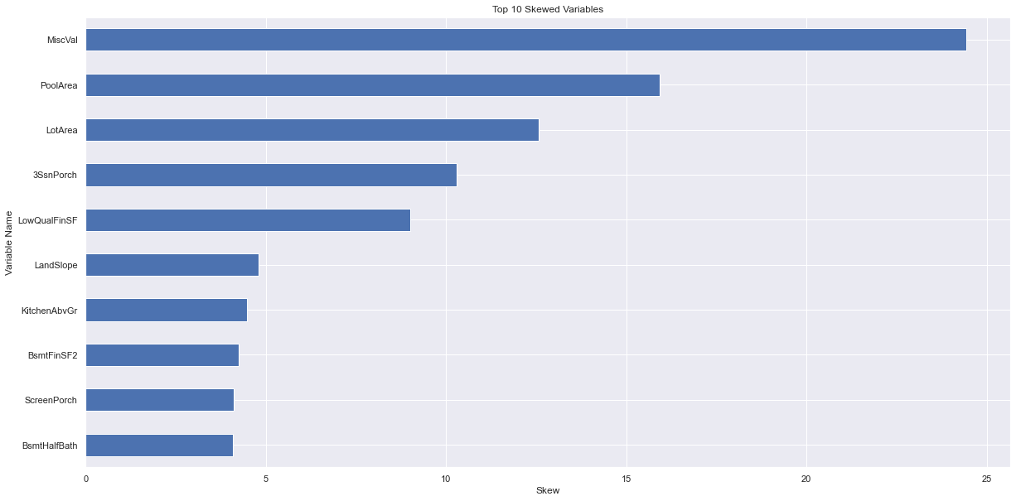
Data Analysis and Visualization
Remove Skew Features
Removed 61 features with a skew greater than 0.75
Feature Engineering
Created “Total Square Footage” Feature
Total Square Footage = Basement Square Footage + 1st Floor Square Footage + 2nd Floor Square Footage

Slide 14
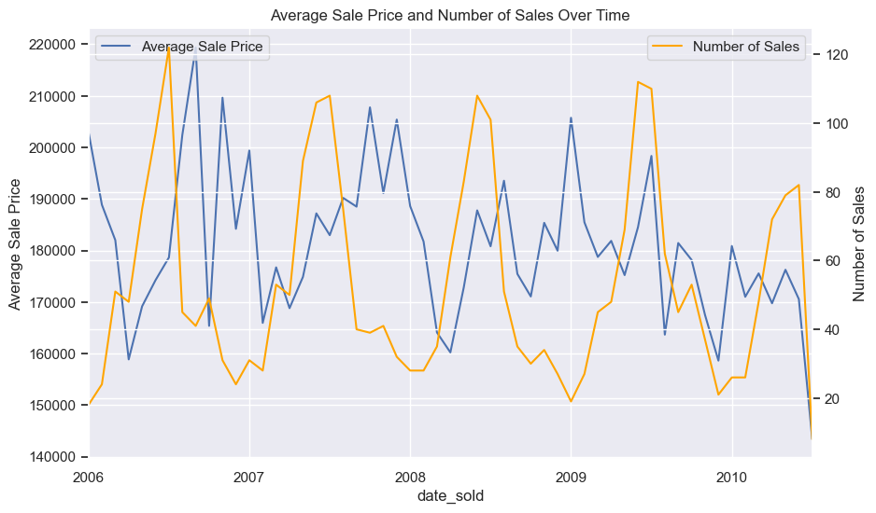
Data Analysis and Visualization
We see sale price is seasonal and is inversely related with demand

Slide 15
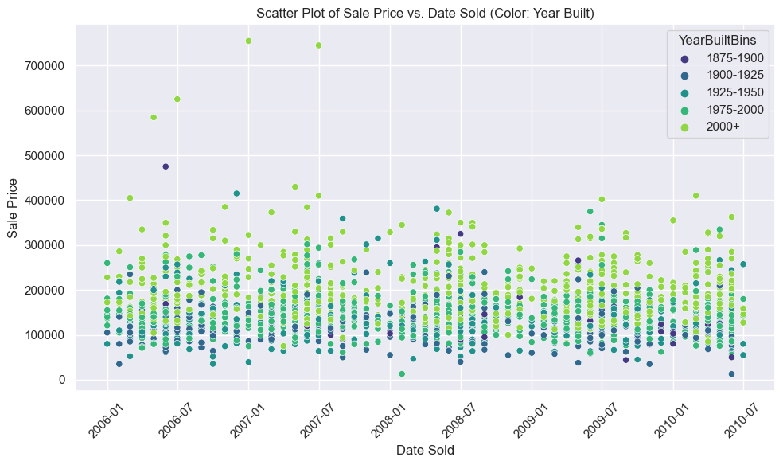
Data Analysis and Visualization
We see newer houses usually sell for more.

Slide 16
Data Analytics

Slide 17
Data Analytics
Used a 5 fold time-series cross-validation
Trained different models using the following algorithms:
Linear Regression (with and without intercept)
Elastic Net
K-Nearest Neighbors Regressor
Decision Tree
Random Forest
Gradient Boosted Machines
XGBoost
LightGBM
We also used the best performing models and created a meta learner model from these
Root Mean Square Error was used as evaluation metric
This was selected as the root attempts to minimize the impact of incorrect predictions on outliers

Slide 18
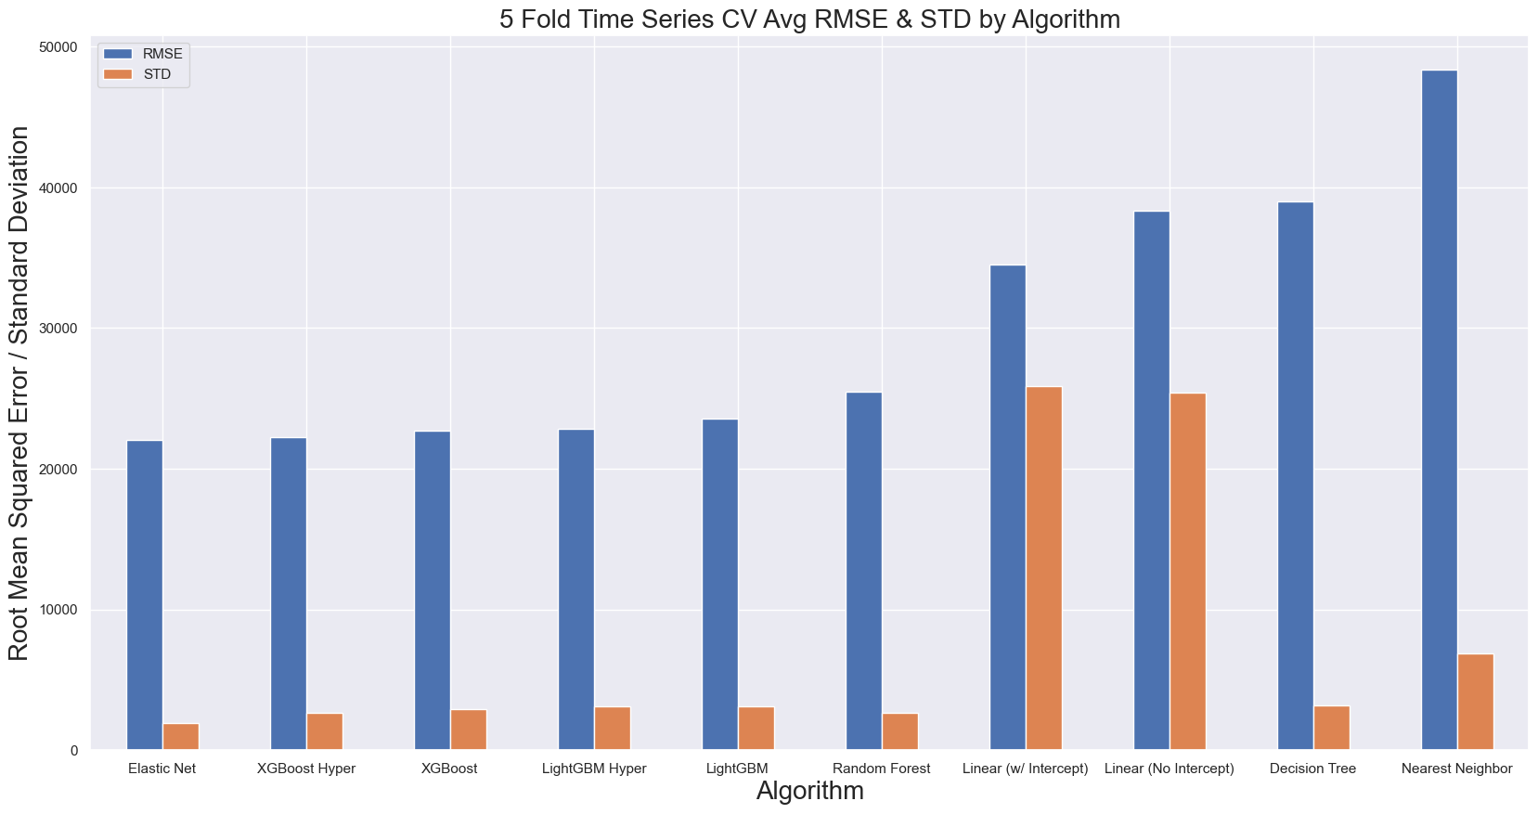
Data Analytics
5 fold time-series cross-validated results
Linear models had extremely high RMSE in the first fold due to a small amount of training data

Slide 19
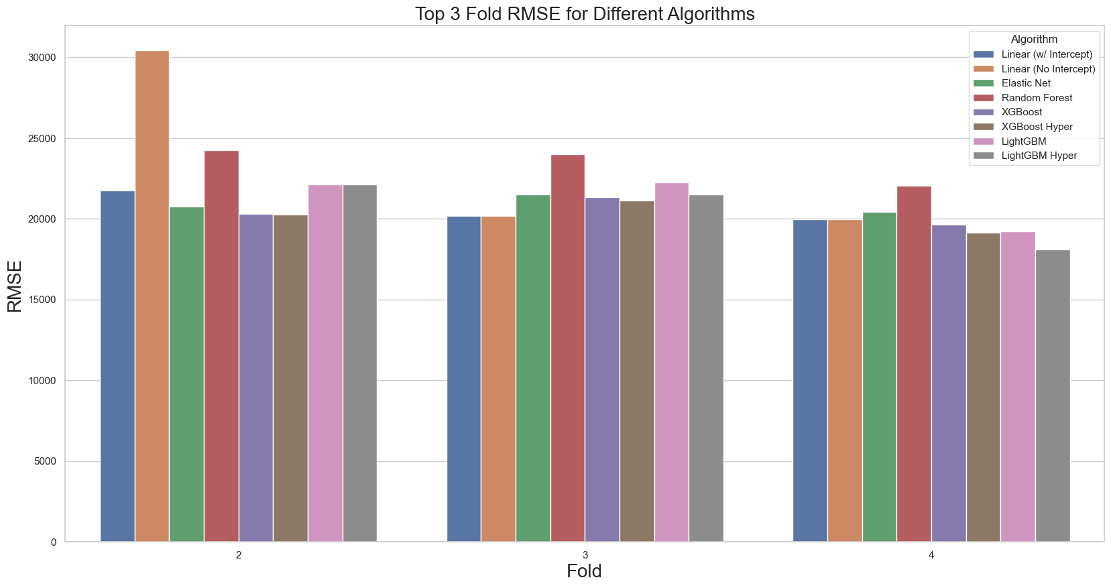
Data Analytics
Top 3 fold results
We tuned the hyper parameters of XGBoost and LightGBM

Slide 20
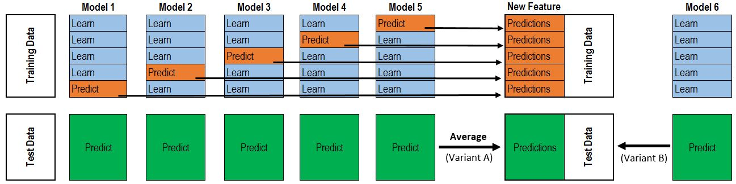
Data Analytics
We create a stacked ensemble meta-learner model from our best performing models:
Base models:
XGBoost, LightGBM, Linear model with intercept
Meta model:
Elastic Net

Slide 21
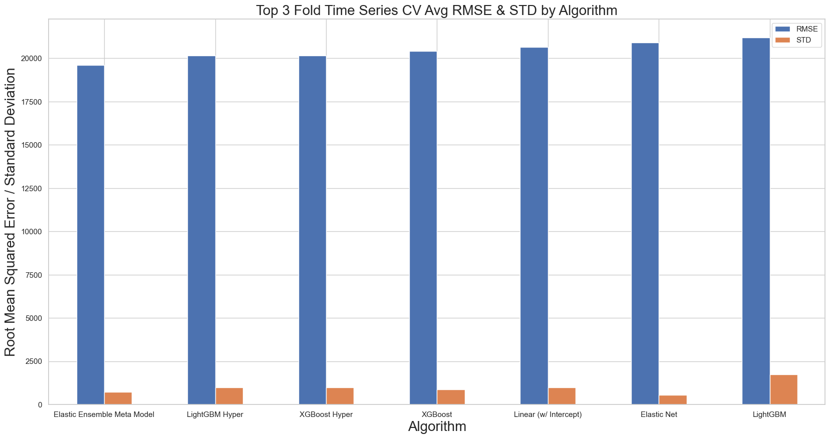
Data Analytics
Top 3 fold results with meta model learning

Slide 22
Data Analytics
We see that the meta learner model performs the best as expected
We will select this model for implementation but acknowledgingg the following:
This is the most complex model for implementation and would need to consult with our implementation team about the tradeoffs of implementation this mode, versus something more simplistic

Slide 23
Questions?

Slide 24
Appendix

Slide 25
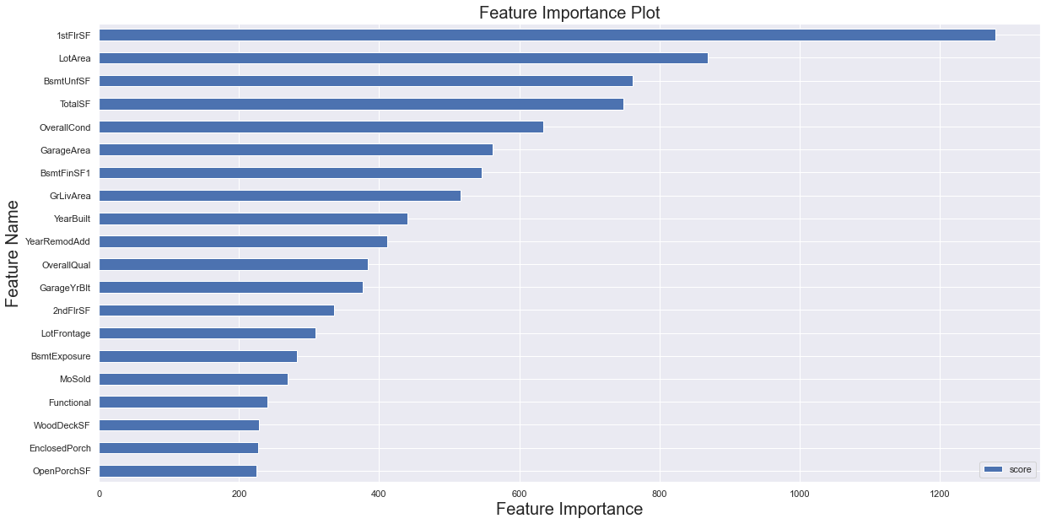
Data Analytics

